Slide 1
-PARALLEL AND DISTRIBUTED COMPUTING- PRESENTATION
BSCS 7A

Slide 2
GROUP MEMBERS:
Umair Ramzan
Habib Ullah
Raheel Tariq
Siraj Muneer

Slide 3
ISSUES:
Issues in Sorting on Parallel Computers
1.Where the input and output sequences are sorted
2.How comparisons are performed
(i).one element per process
(ii).More than one element per process

Slide 4
1.Where the input and output is stored
1.We assume that the input and output lists are distributed.
2.The sorted list is partitioned with the property that each partitioned list is sorted and each element in processor P_{i}'s list is less than that in P_{j}'s list if i<j.

Slide 5
Where I/P & O/P stored
Distributed among process
Stored on
one process
List of the
procesess
P1<P2<P3

Slide 6
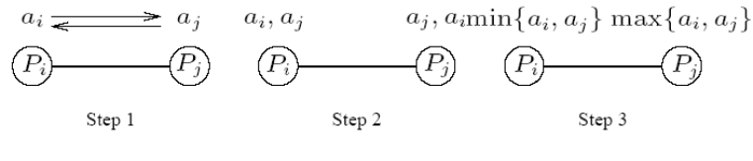
2.How comparisons are performed
(i).one element per process
A parallel compare-exchange operation. Processes P_{i}and P_{j} send their elements to each other. Process P_{i} keeps min{a_{i},a_{j}}, and P_{j} keeps max{a_{i}, a_{j}}.

Slide 7
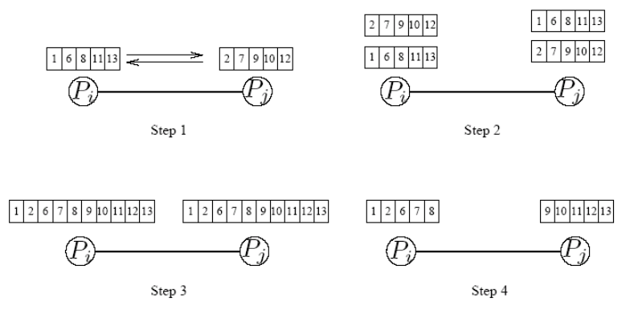
(ii).More than one element per process

Slide 8
1.A compare-split operation.
2.Each process sends its block of size n/p to the other process.
3.Each process merges the received block with its own block and retains only the appropriate half of the merged block. In this example, process Pi retains the smaller elements and process Pi retains the larger elements.

Slide 9
Sorting Network
Sorting Network 1. Sorting Network is used for parallel processing i.e. Many comparisons can be done in parallel. So, speed is very high. 2. Sorting can be done on hardware as well as software. Comparison network mainly focuses on Hardware implementation.
3. Complexity is reduced to O(login) due to parallel processing. While each comparator takes O(1) time.

Slide 10
Sorting networks are Consist Of:- 1. Comparators 2. Wires (Connected parallely)

Slide 11
Comparison Network A Comparison Network is composed of wires and comparators. A comparator is a device with two inputs, x and y, and two outputs, x' and y', that performs the following function: x' = min(x, y) and y'=max(x, y)
Each comparator:-
2 inputs = x,y
2 outputs = x',y'

Slide 12
Comparison Network A Comparison Network is composed of wires and comparators. A comparator is a device with two inputs, x and y, and two outputs, x' and y', that performs the following function: x' = min(x, y) and y'=max(x, y)
x
Comparator
x'=min(x,y)
y
y'=max(x,y)
7
3
x
x'=min(x,y)
3
7
y
y'=max(x,y)

Slide 13
The values of input wires is called input sequence < a1, a2, ......, an > and the value of output wire is called output sequence < b1, b2, ....... bn> Comparison n/w for which the output sequence is monotonically increasing for every i/p sequence i.e. b1 ≤ b2 ≤ 63........≤ bn.
For n comparators:-
n inputs = a1,a2,a3....an
n outputs = b1,b2,b3....bn

Slide 14
1.Generally, we used the convention of drawing comparators as single vertical lines.
2.A comparator sorts its two input lines 3.We assume that the time between the appearance of input values x and y and the production of output values x' and y' is constant i.e. each comparator operates in O(1) time
4.A wire transmits a value from place to place. Wire can be used to connect the output of one comparator to the input of another so are called either network input wires or network output wires

Slide 15
Example
9
5
5
2
2
a1
b1
5
9
9
6
6
5
5
a2
b2
2
2
2
5
5
6
a3
b3
6
6
9
9
a3
b4

Slide 16
BITONIC SORTING NETWORK
1.Bitonic sort is a classic parallel algorithm for sorting.
2.Bitonic Merge Sort does O(login) Comparisons because we always compare elements in
predefined sequence and this sequence does not depend on data.
3.Thus, used for implementation in hardware and parallel processor arrays.

Slide 17
A Bitonic Sequence is a sequence that Firstly Monotonically Increases and then Monotonically Decreases, or can be circularly shifted to become Monotonically Increasing and then Monotonically Decreasing. For example, the sequences <1, 4, 6, 8, 3, 2>, <6, 9, 4, 2, 3, 5>, and <9, 8, 3, 2, 4, 6> are bitonic. Any sorting network (i.e. comparison network) that can sort any bitonic sequence is called bitonic sorting network.
1,2,3,4,5
1,2,3,4,5
4,3,2,1
4,3,2,1
e.g. <1, 2, 3, 4, 5, 4, 3, 2, 1, > are bitonic.

Slide 18
List=1,3,6,8,7,5,4,2
a1
b1
a2
b2
a3
b3
a4
b4
a5
b5
a6
b6
a7
b7
a8
b8

Slide 19
BUBBLE SORT:
Bubble sort, is a simple sorting algorithm that works by repeatedly stepping through the list to be sorted, comparing each pair of adjacent items and swapping them if they are in the wrong order. The pass through the list is repeated until no swaps are needed, which indicates that the list is sorted. The algorithm gets its name from the way smaller elements “bubble” to the top of the list. Because it only uses comparisons to operate on elements, it is a comparison sort.

Slide 20
EXAMPLE:
Let us take the array of numbers “6 3 5 2 4”, and sort the array from lowest number to greatest number using bubble sort.

Slide 21
VARIANTS OF BUBBLE SORT:
Odd-Even Sort, is basically a variation of bubble sort. This algorithm is divided into two phases- Odd and Even Phase. The algorithm runs until the array elements are sorted and in each iteration two phases occurs- Odd and Even Phases. In the odd phase, we perform a bubble sort on odd indexed elements and in the even phase, we perform a bubble sort on even indexed elements.

Slide 22
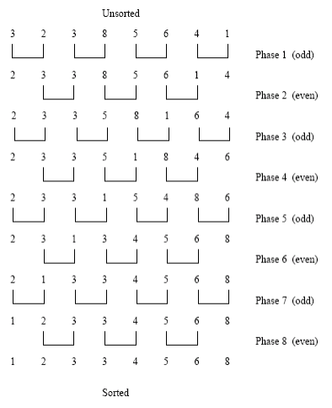
Sorting n = 8 elements, using the odd-even transposition sort algorithm. During each phase, n = 8 elements are compared.

Slide 23
n After n phases of odd-even exchanges, the sequence is sorted.
n Each phase of the algorithm (either odd or even) requires Θ(n) comparisons.
n Serial complexity is Θ(n²).

Slide 24
VARIANTS OF BUBBLE SORT:
Quick sort, is a fast sorting algorithm used to sort a list of elements. The quick sort algorithm attempts to separate the list of elements into two parts and then sort each part recursively. That means it use divide and conquer strategy. In quick sort, the partition of the list is performed based on the element called Pivot. Here pivot element is one of the elements in the list. The list is divided into two partitions such that "all elements to the left of pivot are smaller than the pivot and all elements to the right of pivot are greater than or equal to the pivot".

Slide 25
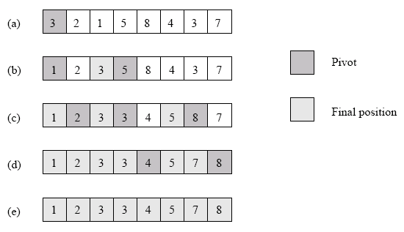
Example of the quicksort algorithm sorting a sequence of size n = 8.

Slide 26
VARIANTS OF BUBBLE SORT:
Bucket sort, is a sorting algorithm that separate the elements into multiple groups said to be buckets. Elements in bucket sort are first uniformly divided into groups called buckets, and then they are sorted by any other sorting algorithm. After that, elements are gathered in a sorted manner.

Slide 27
VARIANTS OF BUBBLE SORT:
Samplesort, is a sorting algorithm that is a divide and conquer algorithm often used in parallel processing systems. Conventional divide and conquer sorting algorithms partitions the array into sub-intervals or buckets. The buckets are then sorted individually and then concatenated together.

Slide 28
Parallel Bucket Sort
n Parallelizing bucket sort is relatively simple. We can select m =p.
n Inthis case, each processor has a range of values it is responsible for.
n Each processor runs through its local list and assigns each of its elements to the appropriate processor.
n The elements are sent to the destination processors using a single all-to-all personalized communication.
n Each processor sorts all the elements it receives.

Slide 29
Parallel Bucket and Sample Sort
n The critical aspect of the above algorithm is one of assigning ranges to processors. This is done by suitable splitter selection.
n The splitter selection method divides the n elements into m blocks of size n/m each, and sorts each block by using quicksort.
n From each sorted block it chooses m – 1 evenly spaced elements.
n The m(m – 1) elements selected from all the blocks represent the sample used to determine the buckets.
n This scheme guarantees that the number of elements ending up in each bucket is less than 2n/m.

Slide 30
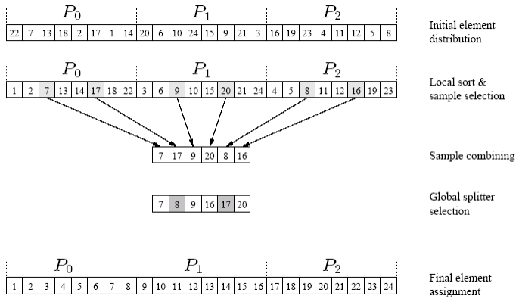
An example of the execution of sample sort on an array with 24 elements on three
processes.

Slide 31
n The splitter selection scheme can itself be parallelized.
n Each processor generates the p – 1 local splitters in parallel.
n All processors share their splitters using a single all-to-all broadcast operation.
n Each processor sorts the p(p – 1) elements it receives and selects p – 1 uniformly spaces splitters from them.

Slide 32
OTHER SORTING ALGORITHMS:
Selection sort
Insertion sort
Merge sort
Heap sort
Counting sort
Radix sort
Shell sort

